Slide 1
Mask DetectION Surveillance
Siddhant Mohanty
Saravanan Balasubramanian
Divya Ramachandran

Slide 2
Why this application
With many states and local authorities insisting on the use of masks when in public places to reduce the spread of COVID-19, this application helps enforce people to wear a mask.
Used to help ensure one’s own safety and the safety of others.
Mask detector surveillance application identifies if a person is wearing a mask or not.
Alerts will be sent with the picture of the person to the respective person or authorities.

Slide 3

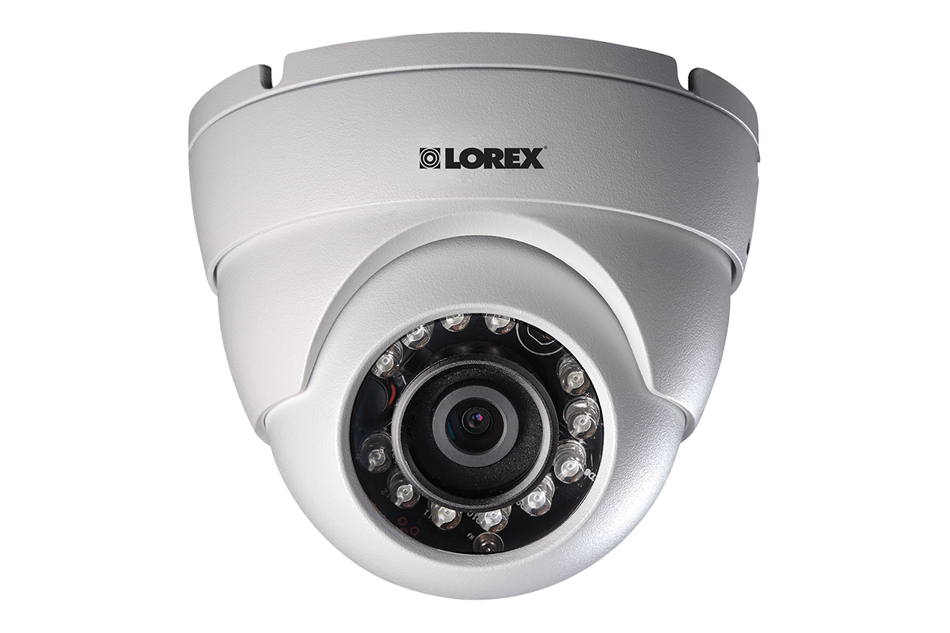
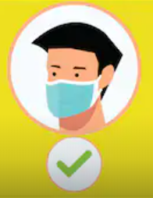
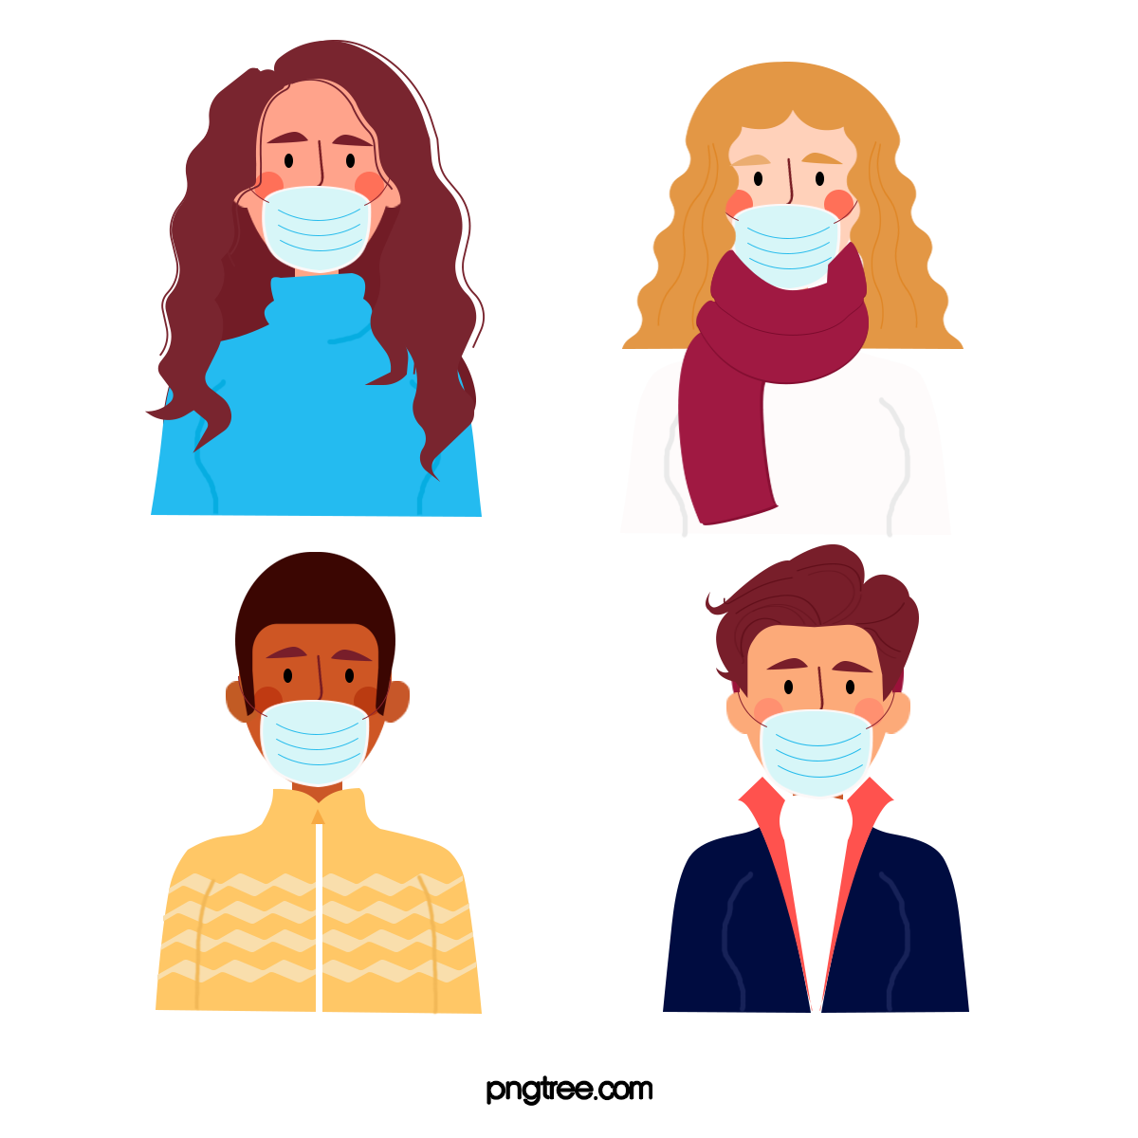



How does it work

Slide 4
Use Cases
At office premises to detect if employees are maintaining safety standards at work. It captures employees without masks and sends them a reminder to wear a mask or sends it to the respective authorities to capture people who are not complying with the defined safety standards at work.
At airports to detect travelers without masks. Face data of travelers can be captured in the system at the entrance. If a traveler is found to be without a face mask, their picture is sent to the airport authorities so that they could take quick action.
At hospitals, religious places of worship, public gatherings etc.

Slide 5
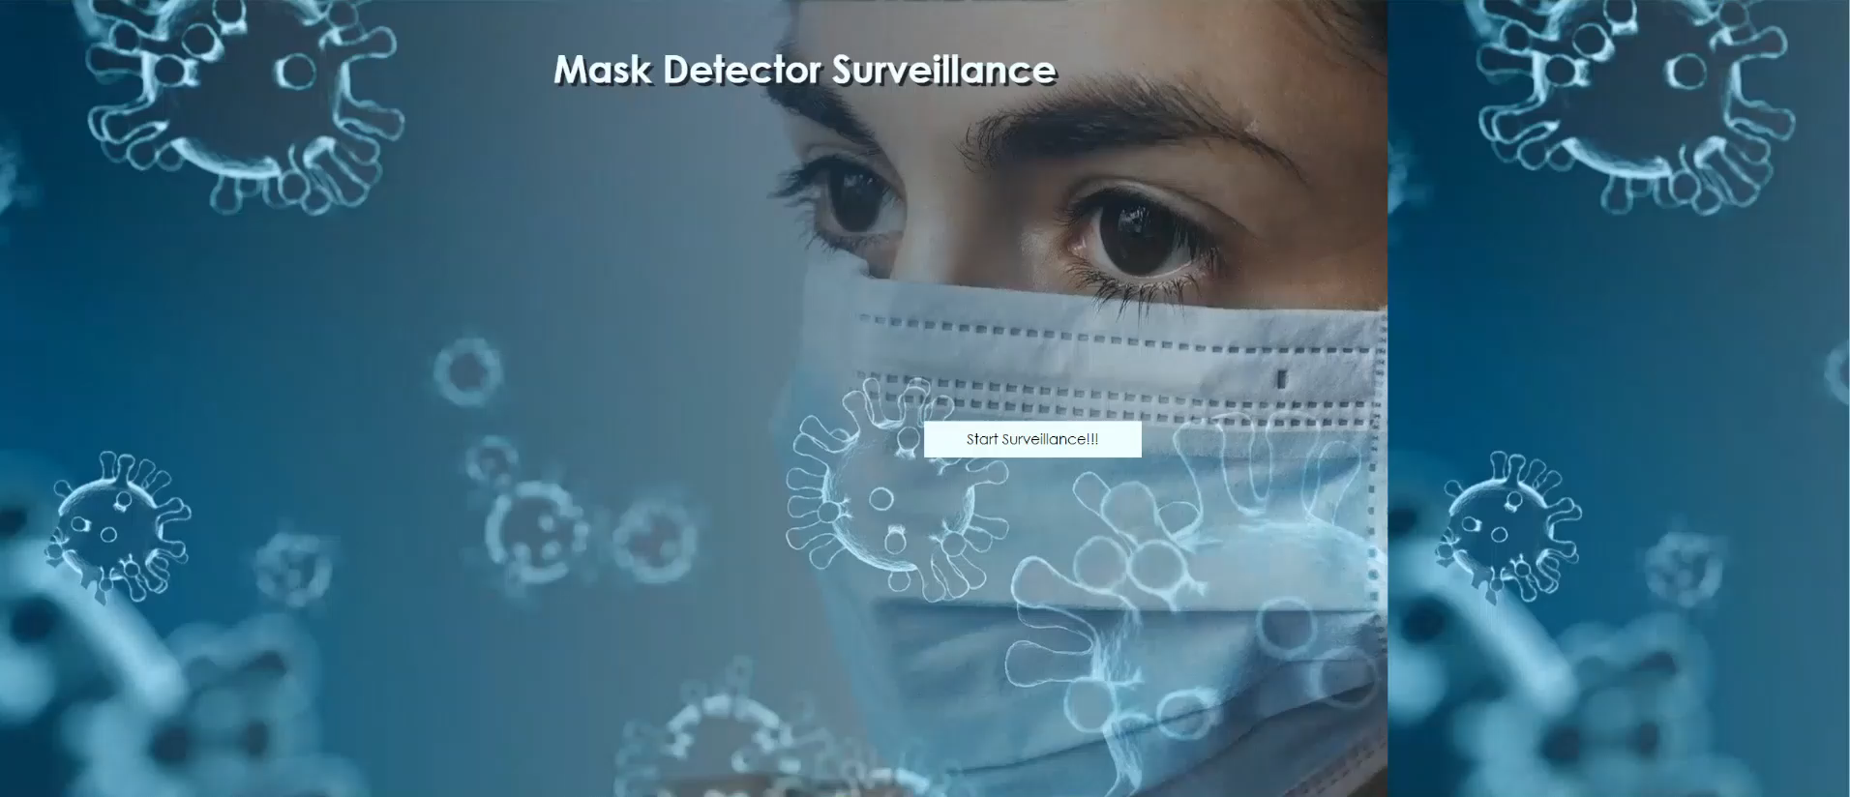
Demo

Slide 6
THANK YOU

